Slide 1
QUESTION PAPER FRAMER

Slide 2
ID | NAME
190030208 | BORRA BHARGAVA TEJA

Slide 3
ABOUT
Toppers from all exams say “Solving more number of the practice tests helps to achieve a higher score and crack any exam”
Following this, Institutes/Teachers are expected to conduct more number of practice tests from question banks for o their students to achieve a higher score in exams, for which Institute/Teachers need to prepare more and more Question Papers.
This is very difficult to do with the conventional way of preparing Question papers.question papres framers to break all barriers and prepare Question Paper whether it is IN-SEM or FINAL or any other practice tests with less time. This will definitely help institutes to improve on student's results

Slide 4
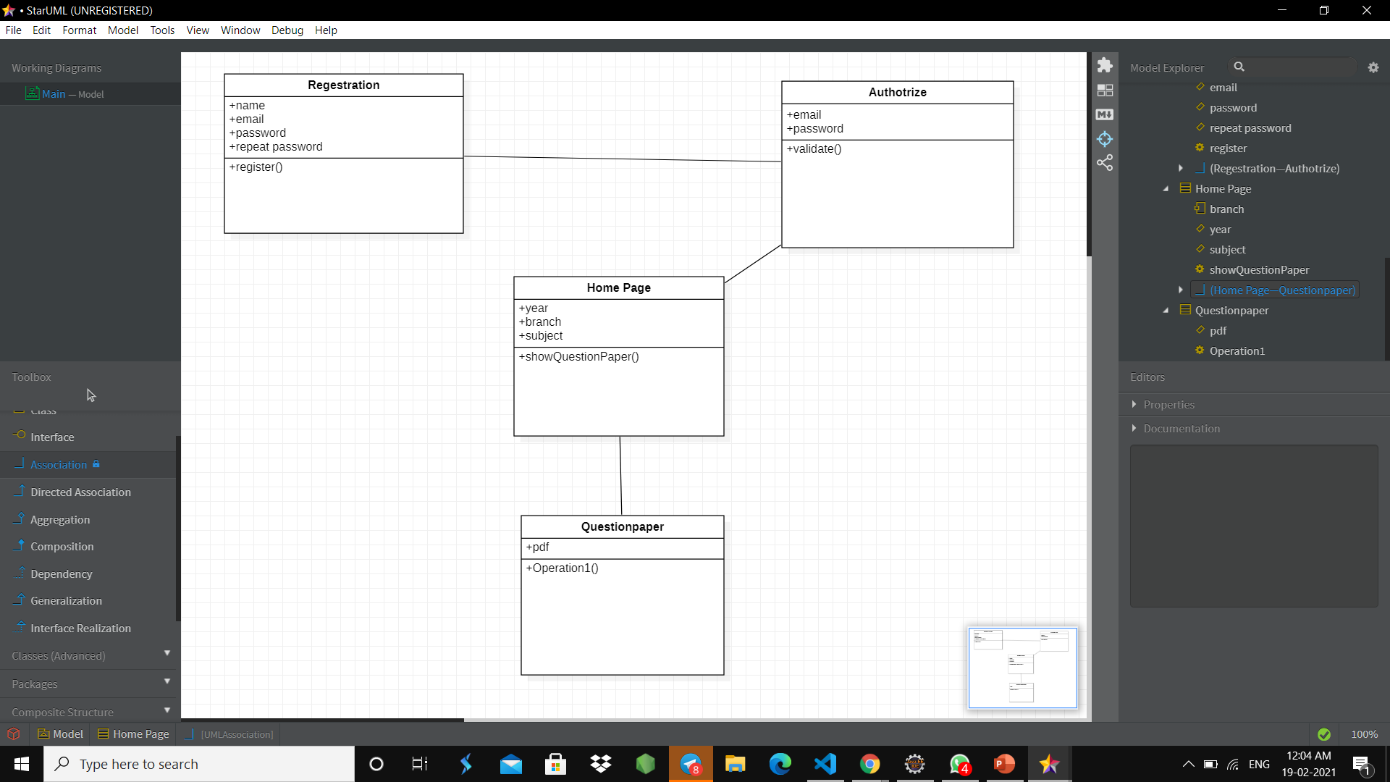
CLASS DIAGRAM

Slide 5
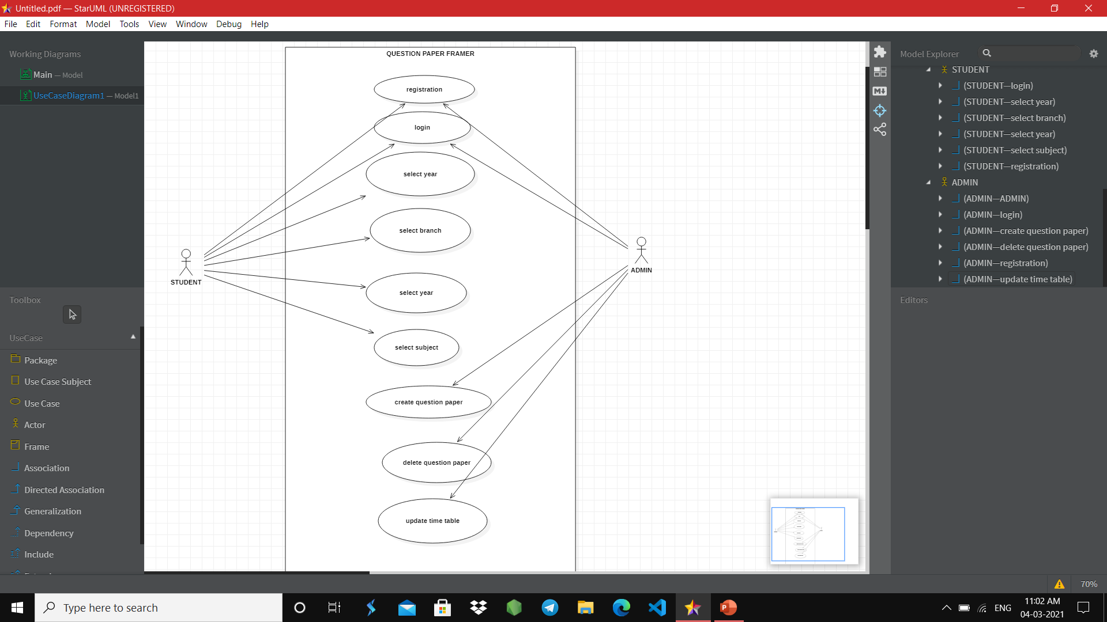
USE CASE DIAGRAM

Slide 6
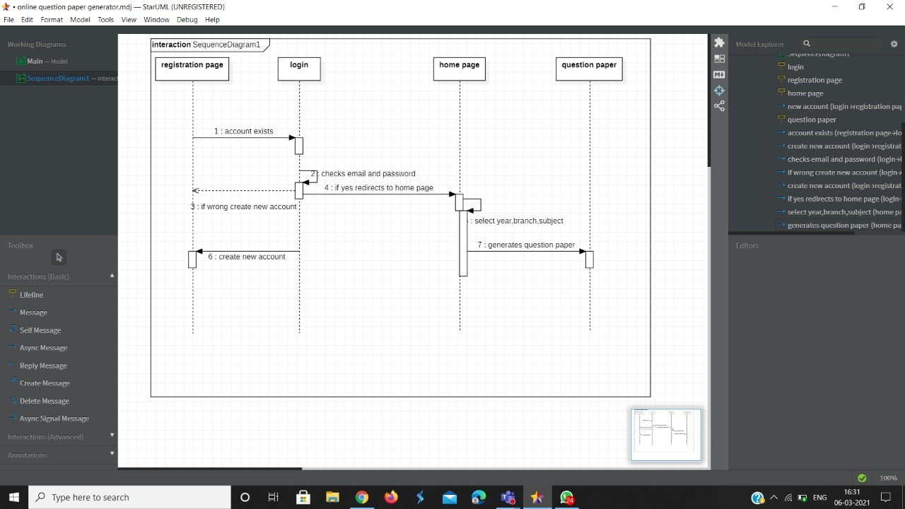
SEQUENCE DIAGRAM

Slide 7
STUDENT MODULE
1)This module provides student to register/signup
2)This module provides the student to log in
3)After log in he will be redirected to the home page
4)In home page he has to select branch,year,subject
5)According to his inputs the question paper will be generated
6)In the navigation bar he can able to see the time-table for the exams

Slide 8
ADMIN MODULE
In this module admin can log in
After log-in he can perform CURD operations on question paper
He can also update timetable of exams

Slide 9
TEST CASES

Slide 10
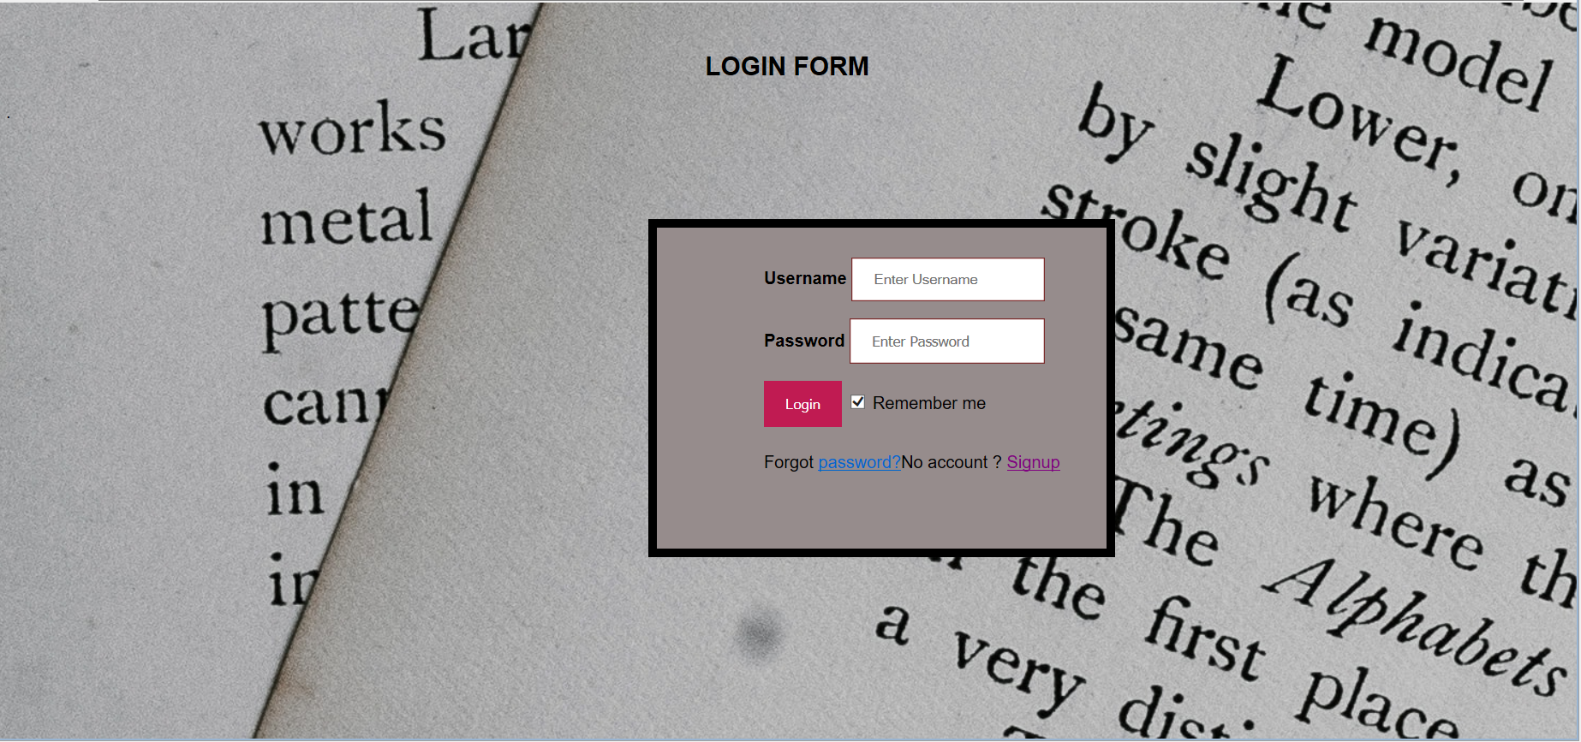

Slide 11


Slide 12
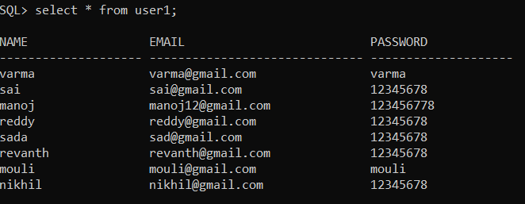

Slide 14
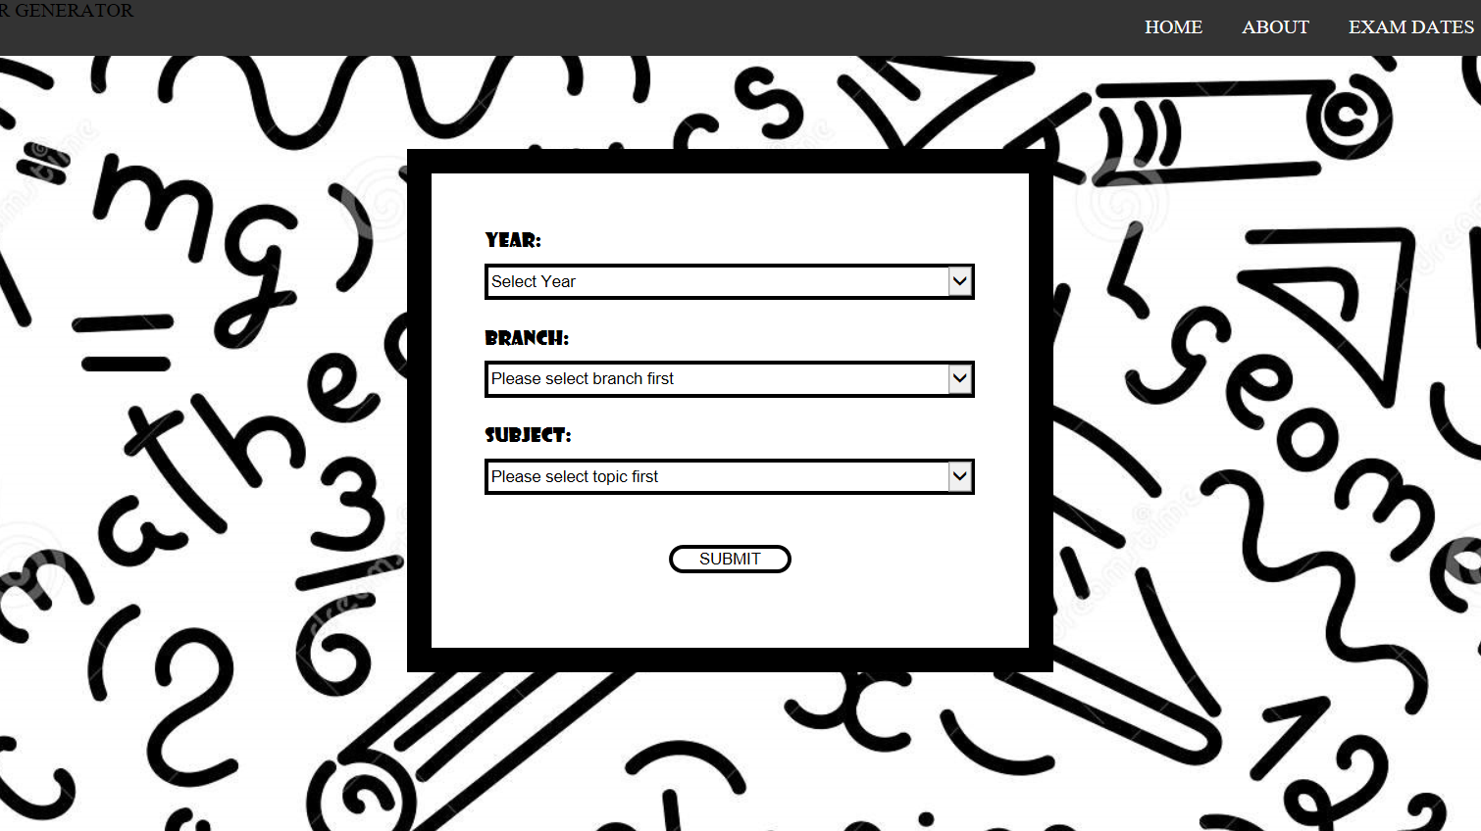

Slide 15
SOFTWARE REQUIREMENTS
ECLIPSE
ORACLE
MYSQL
APACHE TOMCAT

Slide 16
HADWARE REQUIREMENTS
8GB RAM
I5

Slide 17
CONCLUSION
This project will provide free questions papers for students so that they can practice well and they will perform well in examinations

